Slide 1
AWS

Slide 2
Collecting Streaming Data – Kinesis Streams

Slide 3
Agenda
Kinesis Streams Introduction, Core Concepts
Kinesis data streams
Kinesis video streams
Kinesis Streams Emitting Data to AWS Services
Kinesis Data Firehose
Kinesis Data analytics
Amazon Managed Service for Kafka (MSK)
SQS
IoT

Slide 4
What is Streaming Data?
Streaming data is data that is generated continuously by thousands of data sources, which typically send in the data records simultaneously, and in small sizes (order of Kilobytes).
It includes a wide variety of data such as log files generated by customers using your mobile or web applications, ecommerce purchases, in-game player activity, information from social networks, financial trading floors, or geospatial services, and telemetry from connected devices or instrumentation in data centers.
This data needs to be processed sequentially and incrementally on a record-by-record basis or over sliding time windows and is used for a wide variety of analytics including correlations, aggregations, filtering, and sampling.
Notes:
Reference for contents: https://aws.amazon.com/streaming-data/
More explanation:
--Information derived from such analysis gives companies visibility into many aspects of their business and customer activity such as –service usage (for metering/billing), server activity, website clicks, and geo-location of devices, people, and physical goods –and enables them to respond promptly to emerging situations.
--Streaming data processing is beneficial in most scenarios where new, dynamic data is generated on a continual basis.

Slide 5
Kinesis Streams
Amazon Kinesis Data Streams is used to collect and process large streams of data records in real time.
It enables users to ingest real-time data such as video, audio, application logs, website clickstreams, and IoT telemetry data for machine learning, analytics, and other applications.
It is fully managed and runs the streaming applications without requiring users to manage any infrastructure.
It can handle any amount of streaming data and process data from hundreds of thousands of sources with very low latencies.
It enables users to process and analyze data as it arrives and respond instantly instead of having to wait until all the data is collected before the processing can begin.
Notes:
Reference for contents:
https://aws.amazon.com/kinesis/?nc=sn&loc=0
https://docs.aws.amazon.com/streams/latest/dev/introduction.html
More explanation:
Kinesis Streams offers key capabilities to cost-effectively process streaming data at any scale, along with the flexibility to choose the tools that best suit the requirements of user’s application.

Slide 6
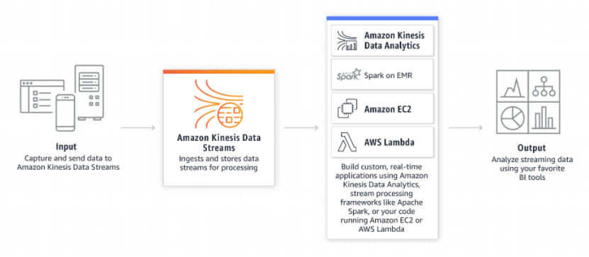
How it works?
Data is put into Kinesis data streams, which ensures durability and elasticity.
A typical Kinesis Data Streams application reads data from a Kinesis stream as data records.
The delay between the time a record is put into the stream and the time it can be retrieved (put-to-get delay) is typically less than 1 second.
Credit: https://aws.amazon.com/kinesis/?nc=sn&loc=0
Notes:
Reference for contents:
https://d0.awsstatic.com/whitepapers/whitepaper-streaming-data-solutions-on-aws-with-amazon-kinesis.pdf
https://docs.aws.amazon.com/streams/latest/dev/introduction.html

Slide 7
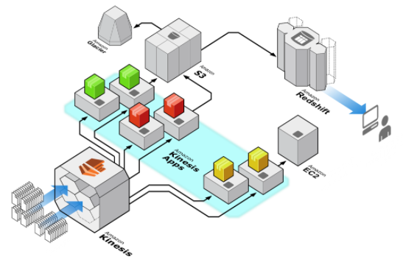
Architecture
Data from a variety of sources is fed into an Amazon Kinesis stream, which is subsequently ingested by multiple Amazon Kinesis apps.
In this example, one application (in yellow) is running a real-time dashboard on the streaming data and another application (in red) does simple aggregation and sends the results to Amazon S3.
Credit: https://aws.amazon.com/kinesis/data-streams/getting-started/?nc=sn&loc=4
Notes:
Reference for contents: https://aws.amazon.com/kinesis/data-streams/getting-started/?nc=sn&loc=4
More explanation:
In the above diagram, Amazon Kinesis Data Streams is used as the gateway of a big data solution.
It's worth noting that all three of these data processing pipelines are running parallelly at the same time.
For complicated analytics, the data in S3 is further analyzed and stored in Amazon Redshift. The third app (in green) uploads raw data to Amazon S3, which is then archived to Amazon Glacier for long-term storage at a lesser cost.

Slide 8
Core Concepts
Data producer - A data producer is an application that typically publishes data records to a Kinesis data stream as they are generated. Records are given partition keys by data producers. In the end, partition keys define which shard ingests a data stream's data record.
Data consumer - A data consumer is a distributed Kinesis application or AWS service that retrieves data as it is generated from all shards in a stream. Consumers retrieve the most recent data in a shard, allowing for real-time analytics or data processing.
Data stream - A data stream is a logical grouping of shards. There are no bounds on the number of shards within a data stream (on demand limit increase). A data stream will retain data for 24 hours by default, or optionally up to 365 days.
Notes:
Reference for contents: https://aws.amazon.com/kinesis/data-streams/getting-started/?nc=sn&loc=4

Slide 9
Core Concepts
Data record - In an Amazon Kinesis stream, a record is the smallest unit of data. A sequence number, partition key, and data blob make up a record. A data blob is the data that the user’s data producer adds to a stream that is of relevance to the user. A data blob (the data payload after Base64 decoding) can be up to 1 megabyte in size (MB).
Partition key - A useful identifier, such as a user ID or timestamp, is often used as a partition key. It's specified by the user’s data producer when they enter data into an Amazon Kinesis data stream, and it's useful for consumers since they may use the partition key to replay or build a history connected with it. The partition key is also used to divide and route data records among a stream's shards.
Sequence number - Each data record has a unique identity called a sequence number. When a data producer utilizes PutRecord or PutRecords API to add data to an Amazon Kinesis data stream, a sequence number is assigned. For the same partition key, sequence numbers tend to increase over time; the longer the duration between PutRecord or PutRecords requests, the greater the sequence numbers get.
Notes:
Reference for contents: https://aws.amazon.com/kinesis/data-streams/getting-started/?nc=sn&loc=4
More explanation:
Partition key (Cont) - Assuming the user has a data stream from Amazon Kinesis with two shards (Shard 1 and Shard 2). User can set up the data producer to utilize two partition keys (Key A and Key B) to add all data records with Key A to Shard 1 and all data records with Key B to Shard 2.

Slide 10
Core Concepts
Shard
A shard is the base throughput unit of streaming capabilities and an append-only log of an Amazon Kinesis data stream.
Using the AWS dashboard, the UpdateShardCount API, AWS Lambda, or an auto scaling utility, users can dynamically add or remove shards from their stream as the data throughput varies.
One shard may consume 1000 data records per second, or 1 megabyte per second. Increase your intake capacity by adding more shards.
Shard-level metrics can be monitored in Amazon Kinesis Data Streams.
Notes:
Reference for contents: https://aws.amazon.com/kinesis/data-streams/getting-started/?nc=sn&loc=4
More explanation:
When consumers register to use enhanced fan-out, one shard delivers 1MB/sec data input and 2MB/sec data output for each data consumer.
A shard provides 1MB/sec of input and 2MB/sec of data output when consumers do not utilize enhanced fan-out, and this output is shared with any consumer who does not use enhanced fan-out.
When building a stream, the user needs to specify the number of shards required and may need to adjust that number at any moment. For a stream with two shards, it can deliver up to 20 MB/sec of total data output if there are 5 data consumers using enhanced fan-out (2 shards x 2MB/sec x 5 data consumers). This stream has a throughput of 2MB/sec data intake and 4MB/sec data output when data consumers are not using enhanced fan-out. This stream permits up to 2000 PUT records per second or 2MB/sec ingress in all situations, whichever comes first.

Slide 11
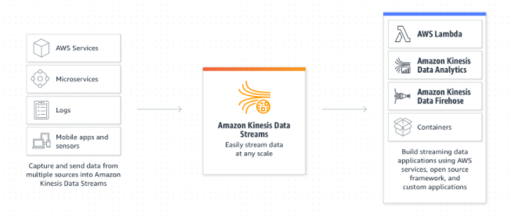
Amazon Kinesis Data Streams
It is a serverless on demand service which eliminates the need to provision or manage capacity required for running applications.
Kinesis Data Streams allows the user to stream gigabytes of data per second with automatic scaling and provisioning of resources.
It supports integrations with other AWS services to create analytics, serverless, and application integration solutions on AWS quickly.
Credit: https://aws.amazon.com/kinesis/data-streams/?nc=sn&loc=1
Notes:
Reference for contents: https://aws.amazon.com/kinesis/data-streams/?nc=sn&loc=1

Slide 12
Amazon Kinesis Data Streams features
Serverless - With Amazon Kinesis Data Streams, there are no servers to manage. By dynamically growing capacity when workload traffic increases, the on-demand mode eliminates the need to provide or control throughput. With a few clicks from the AWS Management Console, user can get started with Kinesis Data Streams.
Highly available and durable - To provide several levels of data loss protection, users can synchronize streaming data across three Availability Zones (AZs) in an AWS Region and store it for up to 365 days.
Low latency - Make your streaming data available to multiple real-time analytics applications, to Amazon Kinesis Data Analytics, or to AWS Lambda within 70 milliseconds of being collected.
Dedicated throughput per consumer - Up to 20 consumers can be attached to a Kinesis data stream, each with its own dedicated read throughput.
Notes:
Reference for contents: https://aws.amazon.com/kinesis/data-streams/features/?nc=sn&loc=2

Slide 13
Amazon Kinesis Data Streams features
Choose between on-demand and provisioned capacity mode – The user can select between automated capacity management in on-demand mode and granular control over scaling capacity up and down as needed in provisioned mode.
Secure and compliant – To fulfil legal and compliance requirements, users can encrypt sensitive data in Kinesis Data Streams and access it securely via Amazon Virtual Private Cloud (VPC). Server-side encryption and AWS Key Management Service (KMS) keys can be used to secure data while it is in transit.
Integrated with other AWS services – To quickly develop comprehensive applications, Amazon Kinesis Data Streams can be combined with other AWS services including Amazon DynamoDB, Amazon QLDB, Amazon Aurora, AWS Database Migration Service, Amazon Cloudwatch, AWS Lambda, Amazon Kinesis Data Analytics, and Amazon Kinesis Data Firehose.
Notes:
Reference for contents: https://aws.amazon.com/kinesis/data-streams/features/?nc=sn&loc=2

Slide 14
Amazon Kinesis Data Streams Use Cases
Stream log and event data – Users can enable live dashboards, generate metrics, and send data into data lakes, ingest and collect terabytes of data every day from application and service logs, clickstream data, sensor data, and in-app user events.
Run real-time analytics – Using AWS Lambda or Amazon Kinesis Data Analytics, users can create apps for high-frequency event data like clickstream data and get insights in seconds, not days.
Power event-driven applications – Users can pair data streams with AWS Lambda to quickly respond to immediate occurrences or triggers within the event driven applications and adjust accordingly.
Notes:
Reference for contents: https://aws.amazon.com/kinesis/data-streams/?nc=sn&loc=1

Slide 15
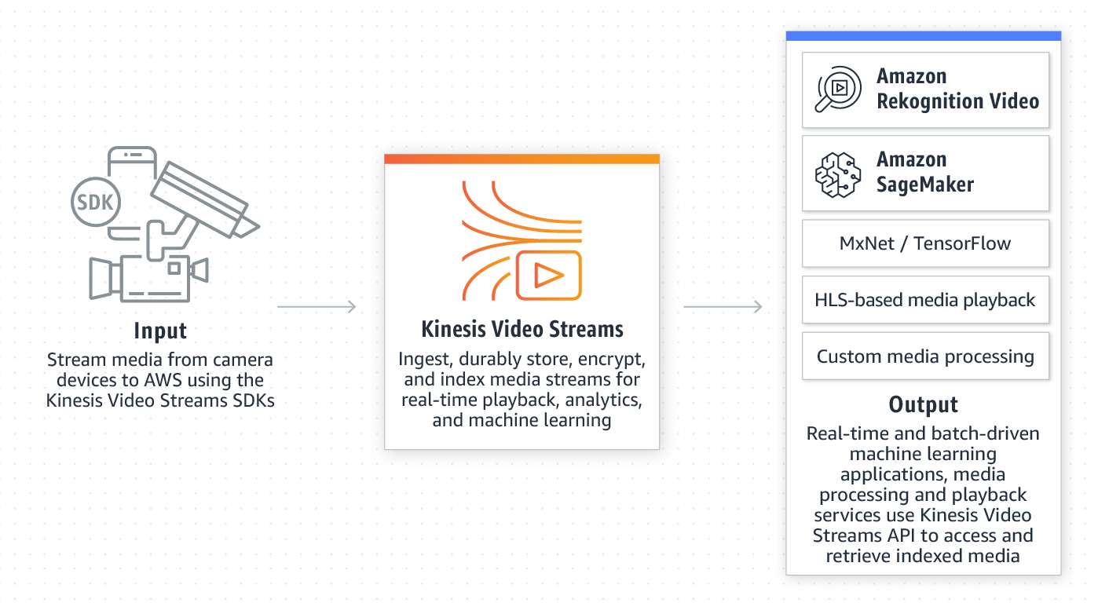
Amazon Kinesis Video Streams
Amazon Kinesis Video Streams is a fully managed AWS service that lets users to stream live video from devices to the cloud, as well as create apps for real-time video processing and batch-oriented video analytics.
Users can monitor live streams in the AWS Management Console or even develop monitoring application to display live video using the Kinesis Video Streams API library.
Credit: https://d1.awsstatic.com/re19/KVS_WebRTC/product-page-diagram_Kinesis-video-streams_how-it-works_01.cb5682fffec40aed239111f7454a586b31d6e680.png
Notes:
Reference for contents:
https://aws.amazon.com/kinesis/video-streams/?nc=sn&loc=0&amazon-kinesis-video-streams-resources-blog.sort-by=item.additionalFields.createdDate&amazon-kinesis-video-streams-resources-blog.sort-order=desc
https://docs.aws.amazon.com/kinesisvideostreams/latest/dg/what-is-kinesis-video.html
More explanation:
Amazon Kinesis Video streams securely saves, encrypts, and indexes video data in your streams and gives you simple access to it via APIs. Through integration with Amazon Rekognition Video and libraries for machine learning frameworks such as Apache MxNet, TensorFlow, and OpenCV, Kinesis Video Streams allows you to playback video for live and on-demand viewing, as well as quickly build applications that take advantage of computer vision and video analytics.
All the infrastructure required to ingest streaming video data from millions of devices is automatically provisioned and elastically scaled by Kinesis Video Streams.

Slide 16
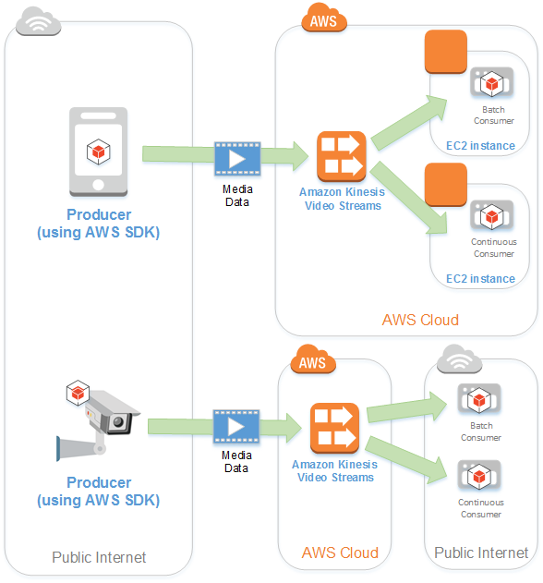
Architecture
Producer – Any data source like video-generating device, such as a security camera, a body-worn camera, a smartphone camera, or a dashboard camera, can be used as a producer.
Kinesis video stream - It allows user to transfer live video data, store and make it available for consumption in real time, in batches, or on an ad hoc basis.
Consumer - Views, processes, and analyses data from a Kinesis video stream
Credit: https://docs.aws.amazon.com/kinesisvideostreams/latest/dg/how-it-works.html
Notes:
Reference for contents:
https://docs.aws.amazon.com/kinesisvideostreams/latest/dg/how-it-works.html
More explanation:
The above diagram provides an overview of how Kinesis Video Streams works.
Non-video data, such as audio feeds, pictures, or RADAR data, can also be sent by a producer.
A Kinesis video stream typically has only one producer posting data into it in a normal configuration.
. When low latency processing is not necessary, users can design applications that ingest and process data in Kinesis video streams in real time or after the data has been durably stored and time-indexed. These consumer applications can be built to run on Amazon EC2 instances.

Slide 17
Why use Kinesis Video Streams?
It allows users to stream video from millions of devices.
Users can build real-time vision and video-enabled apps.
Allows users to playback live and recorded video streams.
Allows users to Build apps with two-way, real-time media streaming between connected devices.
Allows users to control access to streams by automatically encrypting the data using AWS Key Management Service (KMS)
User data is stored durably and reliably as it uses Amazon S3 as the underlying data store.
It manages the scaling infrastructure and configuration for the users.
Notes:
Reference for contents: https://aws.amazon.com/kinesis/video-streams/?nc=sn&loc=0&amazon-kinesis-video-streams-resources-blog.sort-by=item.additionalFields.createdDate&amazon-kinesis-video-streams-resources-blog.sort-order=desc
More explanation:
Amazon Kinesis Video Streams SDKs make it simple for devices to securely stream media to Amazon Web Services (AWS) for playback, storage, analytics, machine learning, and other processing. Data from edge devices, cellphones, security cameras, and other data sources such as RADARs, LIDARs, drones, satellites, dash cams, and depth sensors can be ingested by Kinesis Video Streams.
Enables users to easily create applications with real-time computer vision skills and real-time video analytics capabilities using popular open source machine learning frameworks by integrating with Amazon Rekognition Video.
Using the Kinesis Video Streams HTTP Live Streaming (HLS) capabilities, users can easily broadcast live and recorded media from your Kinesis video streams to your browser or mobile application.
For two-way, real-time media streaming across web browsers, mobile applications, and connected devices, Amazon Kinesis Video Streams supports the open-source project WebRTC. With WebRTC support, users can use simple APIs to create rich apps with ultra-low latency and two-way communication between your applications and connected devices, such as video chat and peer-to-peer data sharing.
Using AWS Identity and Access Management, users may manage access to the Amazon Kinesis Video Streams (IAM). It helps to protect the data by encrypting it at rest and in transit using the industry-standard Transport Layer Security (TLS) protocol.
Because Amazon Kinesis Video Streams uses Amazon S3 as its underlying data store, client data is safe and secure. Kinesis Video Streams allows users to rapidly search for and retrieve video fragments based on timestamps generated by devices and services.

Slide 18
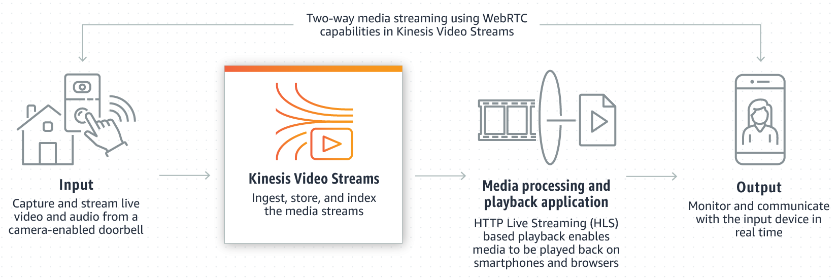
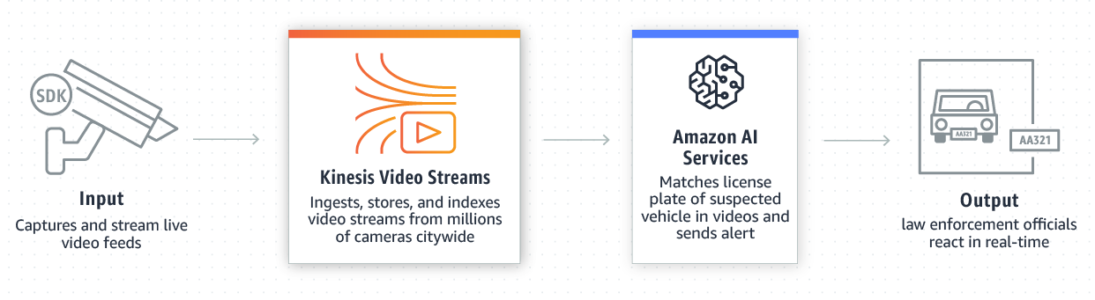
Use cases
Smart home
Interact with a camera-enabled doorbell from your mobile phone.
Smart City
Amber alert system
Credit: https://aws.amazon.com/kinesis/video-streams/?nc=sn&loc=0&amazon-kinesis-video-streams-resources-blog.sort-by=item.additionalFields.createdDate&amazon-kinesis-video-streams-resources-blog.sort-order=desc
Notes:
Reference for contents: https://aws.amazon.com/kinesis/video-streams/?nc=sn&loc=0&amazon-kinesis-video-streams-resources-blog.sort-by=item.additionalFields.createdDate&amazon-kinesis-video-streams-resources-blog.sort-order=desc

Slide 19
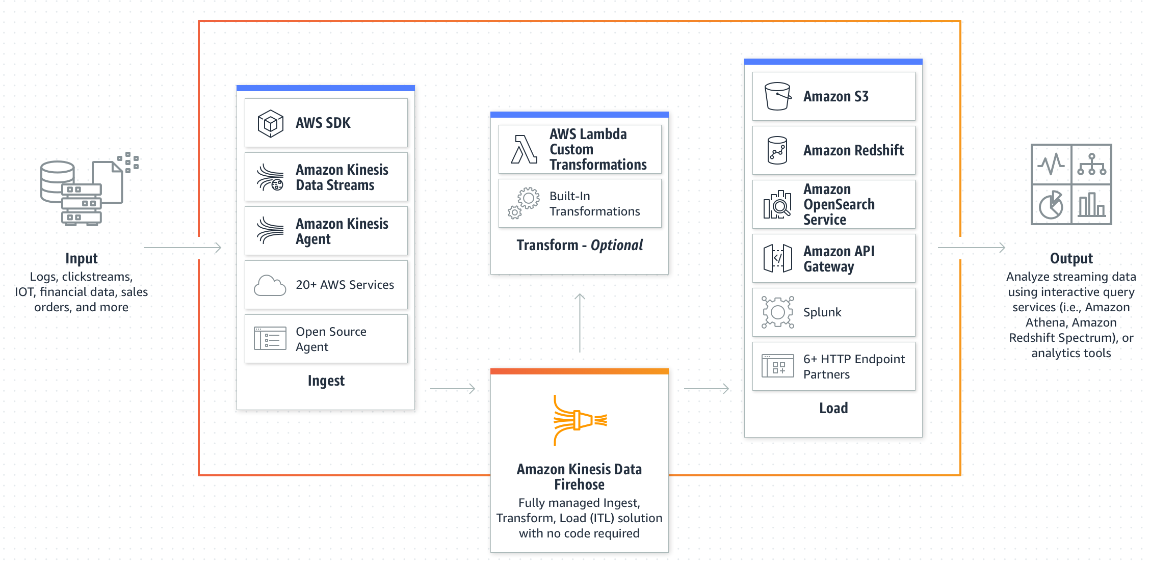
Amazon Kinesis Data Firehose
Amazon Kinesis Data Firehose is an extract, transform, and load (ETL) service that reliably captures, transforms, and delivers streaming data to data lakes, data stores, and analytics services.
Kinesis Data Firehose can batch, compress, and encrypt the data before loading, minimizing the amount of storage used at the destination and increasing security.
Credit: https://aws.amazon.com/kinesis/data-firehose/
Notes:
Reference for contents:
https://aws.amazon.com/kinesis/data-firehose/?nc=sn&loc=0
https://d0.awsstatic.com/whitepapers/whitepaper-streaming-data-solutions-on-aws-with-amazon-kinesis.pdf
More explanation:
Amazon Kinesis Data Firehose is a fully managed serverless service that scales automatically to fit your data flow and doesn't require any ongoing management.
It can use Amazon Kinesis Data Analytics, Amazon Simple Storage Service (Amazon S3), Amazon Redshift, Amazon Elasticsearch Service (Amazon ES), and Splunk to capture, transform, and load streaming data.
It can also use AWS Lambda to alter the source data and deliver the converted data to destinations. Users can set up their data producers to transmit data to Kinesis Data Firehose, which delivers it to the destination you designate automatically.
With Kinesis Data Firehose, users can perform near-real-time analytics with your existing business intelligence tools and dashboards.

Slide 20
Key Concepts
Kinesis Data Firehose delivery stream – Users can create a Kinesis Data Firehose delivery stream and transfer data to it to use Kinesis Data Firehose
Record – Relevant data sent by producer sends to a Kinesis Data Firehose delivery stream. A file can be up to 1,000 KB in size.
Data producer - Records are sent to Kinesis Data Firehose delivery streams by producers. A data producer is, for example, a web server that transmits log data to a delivery stream. Users can also set up your Kinesis Data Firehose delivery stream to read data from another Kinesis data stream and feed it into destinations automatically.
Buffer size and buffer interval - Kinesis Data Firehose buffers incoming streaming data to a certain size or for a certain period before delivering it to destinations. Buffer Size is in MBs, and Buffer Interval is in seconds.
Notes:
Reference for contents: https://docs.aws.amazon.com/firehose/latest/dev/what-is-this-service.html

Slide 21
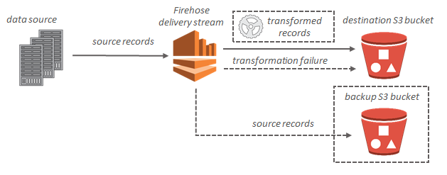
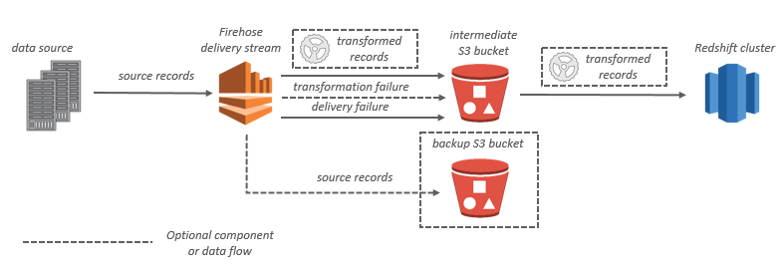
Data Flow in Kinesis Data Firehose
Streaming data is delivered to client’s S3 bucket for Amazon S3 destinations. Client can back up source data to another Amazon S3 bucket if data transformation is enabled.
Streaming data is transmitted to client’s S3 bucket first for Amazon Redshift destinations. The Amazon Redshift COPY command is then used by Kinesis Data Firehose to load data from S3 bucket into Amazon Redshift cluster. Source data can be backed up to another Amazon S3 bucket if data transformation is enabled.
Credit: https://docs.aws.amazon.com/firehose/latest/dev/what-is-this-service.html
Notes:
Reference for contents: https://docs.aws.amazon.com/firehose/latest/dev/what-is-this-service.html

Slide 22
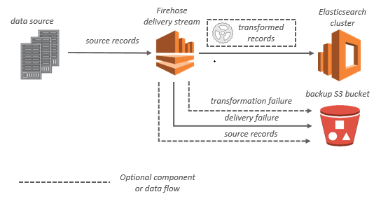
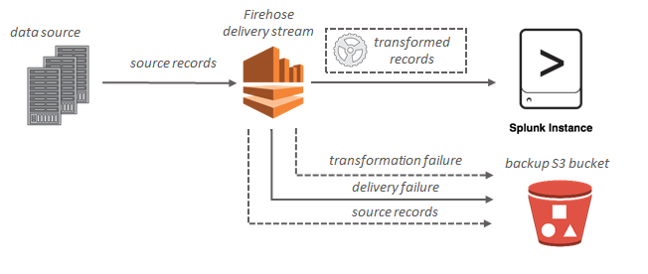
Data Flow in Kinesis Data Firehose
Streaming data is supplied to client’s OpenSearch Service cluster and can optionally be backed up to S3 bucket concurrently for OpenSearch Service destinations.
Streaming data is provided to Splunk and can optionally be backed up to client’s S3 bucket concurrently for Splunk destinations.
Credit: https://docs.aws.amazon.com/firehose/latest/dev/what-is-this-service.html
Notes:
Reference for contents: https://docs.aws.amazon.com/firehose/latest/dev/what-is-this-service.html

Slide 23
Kinesis Data Firehose Key Features
Easy launch and configuration
Load new data in near real time
Elastic scaling to handle varying data throughput
Integrated data transformations
Support for multiple data destinations
Optional automatic encryption
Metrics for monitoring performance
Pay-as-you-go pricing
Notes:
Reference for contents: https://aws.amazon.com/kinesis/data-firehose/features/?nc=sn&loc=2
More explanation:
With a few clicks in the AWS Management Console, you can activate Amazon Kinesis Data Firehose and configure a delivery stream to load data into Amazon S3, Amazon Redshift, Amazon OpenSearch Service, HTTP endpoints, Datadog, New Relic, MongoDB, or Splunk. By using the Firehose API or the Linux agent we provide on the data source, you can transmit data to the delivery stream. The data is then continually loaded into the selected destinations using Kinesis Data Firehose.
To determine how rapidly data is uploaded to destinations, you can define a batch size or batch interval. If you wish to receive fresh data within 60 seconds of submitting it to your delivery stream, for example, you can set the batch interval to 60 seconds. You can also indicate whether data should be compressed. GZip, Hadoop-Compatible Snappy, Zip, and Snappy are among the compression methods supported by the service. You can regulate how quickly you receive new data at the destinations by batching and compressing data before uploading.
Once launched, your delivery streams scale up and down automatically to handle input data rates of gigabytes per second or more, while maintaining data latency at the levels you designate for the stream, within the restrictions. There is no need for intervention or upkeep.
Columnar data formats such as Apache Parquet and Apache ORC are supported by Kinesis Data Firehose and are optimized for cost-effective storage and analytics using Amazon Athena, Amazon Redshift Spectrum, Amazon EMR, and other Hadoop-based technologies. Before storing data in Amazon S3, Kinesis Data Firehose can transform incoming data from JSON to Parquet or ORC formats, saving you money on storage and analytics.
Use static or dynamically created keys like "customer id" or "transaction id" to dynamically split your streaming data before sending it to S3. Kinesis Data Firehose aggregates data into key-unique S3 prefixes, making it easy to do high-performance, cost-effective analytics in S3 with Athena, EMR, and Redshift Spectrum.
You can have your data automatically encrypted after it is uploaded to the destination using Amazon Kinesis Data Firehose. You can specify an AWS Key Management System (KMS) encryption key as part of the delivery stream configuration.
The dashboard and Amazon CloudWatch expose numerous metrics, including the volume of data submitted, the volume of data uploaded to destination, the time from source to destination, the delivery stream restrictions, the number of throttled records, and the upload success rate. These metrics can be used to keep an eye on the health of your delivery streams and take any necessary measures, such as changing destinations or setting alarms when they approach their limitations. They can also be used to verify that the service is absorbing data and loading it to destinations.

Slide 24
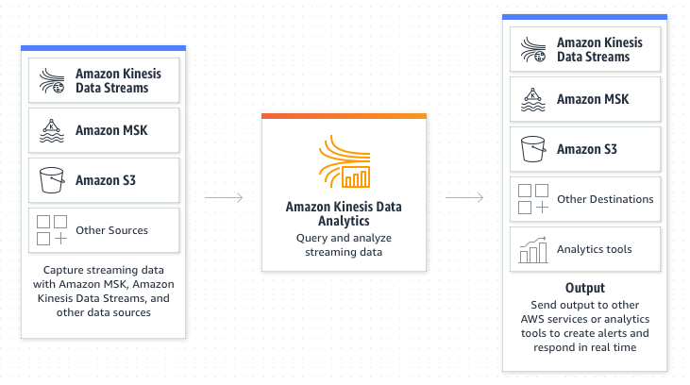
Amazon Kinesis Data Analytics
Kinesis Data Analytics is an AWS serverless service, which means it handles provisioning and elastically extends the infrastructure to handle any data traffic.
Amazon Kinesis Data Analytics can be used to interactively query streaming data using a variety of methods, including Standard SQL, Apache Flink apps written in Java, Python, and Scala, and Apache Beam applications written in Java.
Credit: https://aws.amazon.com/kinesis/data-analytics/
Notes:
Reference for contents:
https://d0.awsstatic.com/whitepapers/whitepaper-streaming-data-solutions-on-aws-with-amazon-kinesis.pdf
https://aws.amazon.com/kinesis/data-analytics/
More explanation:
Using Kinesis Data analytics users can convert and analyze streaming data and respond to abnormalities in real time using Amazon Kinesis Data Analytics.
Since it is serverless eliminates all the undifferentiated heavy work associated with setting up and managing streaming infrastructure, allowing you to focus on creating streaming apps.
It provides the freedom to choose a method based on the complexity of the streaming application and the source/target support.

Slide 25
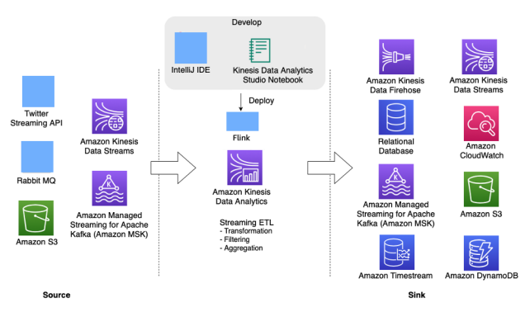
Kinesis Data Analytics for Apache Flink applications
Apache Kinesis Data Analytics Flink allows users to process and analyse streaming data by writing apps in Java, Scala, Python, or SQL.
A typical Flink programme accepts data from an input stream or data location (source), transforms/filters or joins it using operators or functions and saves it to an output stream or data location (sink).
Credit: https://d0.awsstatic.com/whitepapers/whitepaper-streaming-data-solutions-on-aws-with-amazon-kinesis.pdf
Notes:
Reference for contents:
https://d0.awsstatic.com/whitepapers/whitepaper-streaming-data-solutions-on-aws-with-amazon-kinesis.pdf
https://aws.amazon.com/kinesis/data-analytics/
More explanation:
It allows users to run code against streaming sources and perform real time analytics without the need to manage complex Apache Flink environment
For stateful computations across unbounded and bounded data streams, Apache Flink is a popular open-source framework and distributed processing engine.
When hosting the Flink infrastructure, users can use the high-level Flink programming capabilities in the same way.
With support for exactly-one semantics, Apache Flink is designed to perform computations at in-memory speed and scale. Apache Flink-based applications assist in achieving low latency and high throughput while remaining fault resistant.
The above architecture diagram depicts some of the Kinesis Data Analytics Flink application's supported sources and sinks. Users can add custom connectors to a range of alternative source/sinks for Flink Applications on Kinesis Data Analytics in addition to the pre-bundled connectors for source/sink.

Slide 26
Kinesis Data Analytics Features
Deliver streaming data in seconds – Users can create apps that transform and deliver data to Amazon Simple Storage Service (Amazon S3), Amazon OpenSearch Service, and other cloud services.
Create real-time analytics – Insights for time-sensitive use cases can be continuously produced by interactively querying and analyzing data in real time.
Perform stateful processing – Use stateful, long-running computations to trigger real-time actions such as anomaly identification based on past data trends.
Serverless fully managed Apache Flink environment – Users can run their Apache Flink applications indefinitely and scale them up and down without having to manage servers.
Low latencies for real-time data processing – Users can process data from Amazon Kinesis Data Streams and Amazon MSK with sub-second latencies and respond to events in real time.
Notes:
Reference for contents: https://aws.amazon.com/kinesis/data-analytics/

Slide 27
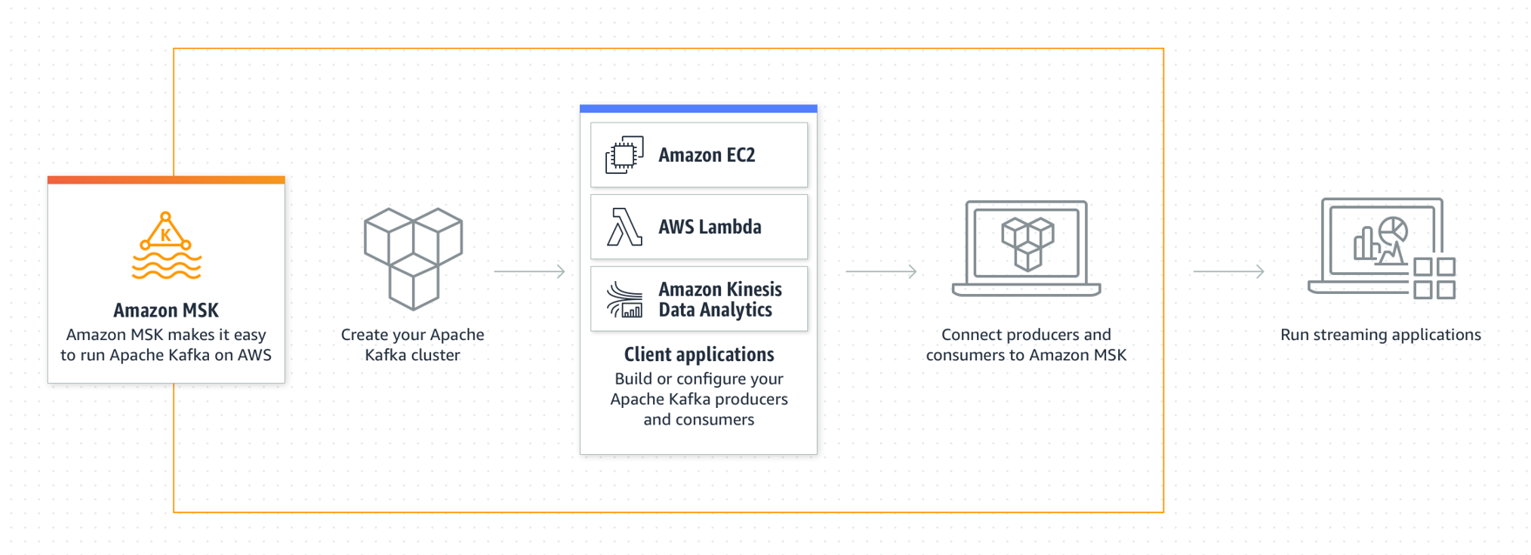
Amazon Managed Streaming for Apache Kafka (MSK)
Apache Kafka is an open-source framework for capturing streaming data, such as click stream events, transactions, IoT events, and application and machine logs.
Customers can transfer and run existing Apache Kafka applications on AWS without having to make modifications to their application code because Amazon MSK runs and administers open-source Apache Kafka.
Credit: https://aws.amazon.com/msk/
Notes:
Reference for contents:
https://aws.amazon.com/msk/
https://d0.awsstatic.com/whitepapers/whitepaper-streaming-data-solutions-on-aws-with-amazon-kinesis.pdf
More explanation:
Apache Kafka is an open-source framework for capturing streaming data, such as click stream events, transactions, IoT events, and application and machine logs. Users may use this data to create apps that execute real-time analytics, run continuous transformations, and disseminate data in real-time to data lakes and databases.
Kafka can be used as a streaming data store to decouple applications from producers and consumers, allowing for reliable data transit between them. While Kafka is a popular enterprise data streaming and messaging platform, setting it up, scaling, and managing it in production may be challenging.
Amazon MSK manages these activities for the client, making it simple to set up, configure, and execute Kafka and Apache Zookeeper in an environment that follows best practices for high availability and security. To manage producing and consuming data, you can still use Kafka's control-plane and data-plane operations.

Slide 28
Amazon MSK Features
Fully managed (No servers to manage)
Apache ZooKeeper included
Data replication
Private connectivity
Granular access control
Encryption at rest and in transit
Deeply integrated with AWS services
Open source (Run with native Apache Kafka)
Notes:
Reference for contents:
https://aws.amazon.com/msk/
https://aws.amazon.com/msk/features/
More explanation:
Apache Kafka is fully managed with Amazon Managed Streaming for Apache Kafka (MSK). This means that Amazon MSK sets up client’s servers, configures their Apache Kafka clusters, replaces servers when they fail, orchestrates server patches and upgrades, architects' clusters for high availability, ensures data is stored and secured durably, sets up monitoring and alarms, and scales to support load changes. Clients can concentrate their time building and running streaming event apps if they use a managed service.
Amazon MSK gives client durable, highly available streaming storage by distributing open-source, highly secure Apache Kafka clusters across several Availability Zones (AZs). The flexibility and control required for varied use cases are provided by Amazon MSK, which is highly adjustable, observable, and scalable.
Because of its strong connections with other AWS services, Amazon MSK makes application development easier. AWS Identity and Access Management (IAM) and AWS Certificate Manager for security, AWS Glue Schema Registry for schema governance, Amazon Kinesis Data Analytics and AWS Lambda for stream processing, and more are all integrated with Amazon MSK. At the heart of data input and processing services, as well as microservice application architectures, Amazon MSK provides the integration backbone for modern messaging and event-driven systems.

Slide 29
Amazon MSK Features
Streamlined version availability
Seamless version upgrades
Lowest cost
Broker scaling (provisioned clusters only)
Cluster scaling (serverless clusters only)
Automatic partition management
Automatic storage scaling (provisioned clusters only)
Easy observability of streaming performance with CloudWatch metrics by default
Notes:
Reference for contents:
https://aws.amazon.com/msk/
https://aws.amazon.com/msk/features/
More explanation:
Apache Kafka is fully managed with Amazon Managed Streaming for Apache Kafka (MSK). This means that Amazon MSK sets up client’s servers, configures their Apache Kafka clusters, replaces servers when they fail, orchestrates server patches and upgrades, architects' clusters for high availability, ensures data is stored and secured durably, sets up monitoring and alarms, and scales to support load changes. Clients can concentrate their time building and running streaming event apps if they use a managed service.
Amazon MSK gives client durable, highly available streaming storage by distributing open-source, highly secure Apache Kafka clusters across several Availability Zones (AZs). The flexibility and control required for varied use cases are provided by Amazon MSK, which is highly adjustable, observable, and scalable.
Because of its strong connections with other AWS services, Amazon MSK makes application development easier. AWS Identity and Access Management (IAM) and AWS Certificate Manager for security, AWS Glue Schema Registry for schema governance, Amazon Kinesis Data Analytics and AWS Lambda for stream processing, and more are all integrated with Amazon MSK. At the heart of data input and processing services, as well as microservice application architectures, Amazon MSK provides the integration backbone for modern messaging and event-driven systems.

Slide 30
Amazon Simple Queue Service
SQS (Amazon Simple Queue Service) is a fully managed message queuing service for decoupling and scaling microservices, distributed systems, and serverless applications.
Using the AWS Management Console, your preferred Command Line Interface or SDK, and three easy commands, you can get started with SQS in minutes.
SQS provides two different types of message queues. Standard queues provide high throughput, best-effort ordering, and delivery at least once. FIFO queues are meant to ensure that messages are processed only once, in the sequence in which they are received.
Notes:
Reference for contents:
https://aws.amazon.com/sqs/
https://docs.aws.amazon.com/AWSSimpleQueueService/latest/SQSDeveloperGuide/welcome.html
More explanation:
SQS removes the complexity and overhead of managing and operating message-oriented middleware, allowing developers to concentrate on work that is unique. You may send, store, and receive messages across software components using SQS at any volume without losing messages or necessitating the availability of other services.

Slide 31
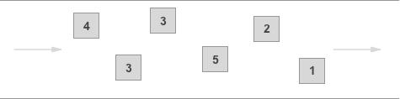

Queue Types
Standard Queues – A practically infinite number of transactions per second (TPS) are supported by standard queues for each API action. A message is delivered at least once, but it is sometimes given in several copies. Messages may occasionally be delivered in a different sequence from when they were sent.
FIFO Queues - A message is sent once and remains available until it is processed and deleted by the recipient. There are no duplicates added to the queue. The order of sending and receiving messages is rigorously adhered to (i.e., First-In-First-Out).
Credit: https://aws.amazon.com/sqs/features/
Notes:
Reference for contents: https://aws.amazon.com/sqs/features/
More explanation:
FIFO queues may handle up to 300 messages per second by default (300 send, receive, or delete operations per second). FIFO queues may support up to 3,000 messages per second when batching 10 messages per operation (maximum). If more throughput is needed, users can use the Amazon SQS console to select high throughput mode for FIFO, which supports up to 30,000 messages per second with batching and up to 3,000 messages per second without batching.

Slide 32
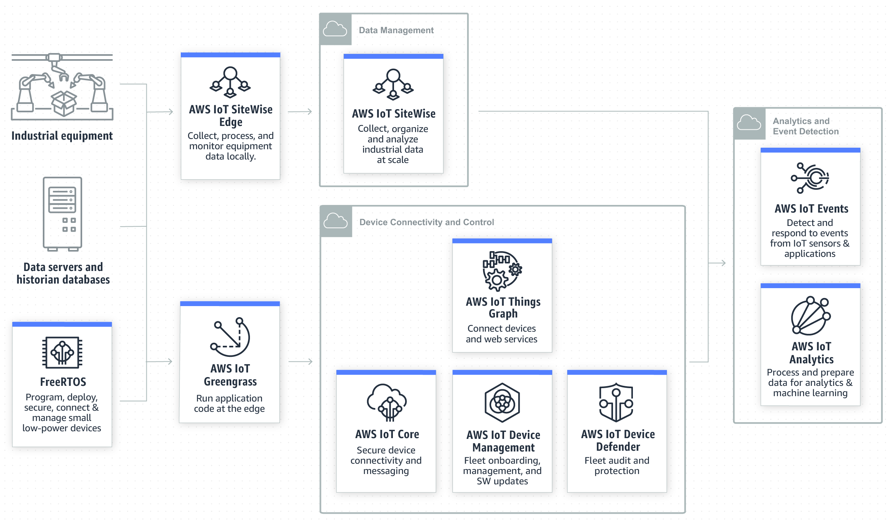
AWS IoT
AWS offers Internet of Things (IoT) services and solutions to connect and manage billions of devices. Users can collect, store, and analyze IoT data for industrial, consumer, commercial, and automotive workloads.
AWS IoT Solutions include:
IoT Solution Repository
IoT for the Edge
Industrial IoT
IoT for Connected Home
AWS IoT and Amazon Alexa
AWS IoT Migrations
Credit: https://aws.amazon.com/iot/solutions/industrial-iot/?nc=sn&loc=3&dn=3
Notes:
Reference for contents:
https://aws.amazon.com/iot/?nc=sn&loc=0
https://aws.amazon.com/iot/solutions/industrial-iot/?nc=sn&loc=3&dn=3
https://aws.amazon.com/iot/solutions/connected-home/?nc=sn&loc=3&dn=4
https://aws.amazon.com/iot/solutions/iot-edge/?nc=sn&loc=3&dn=2
More explanation:
Industrial IoT (IIoT) connects traditional industrial equipment and infrastructure with cutting-edge technologies including machine learning, cloud, mobile, and edge computing. Customers utilise IIoT solutions to monitor their operations remotely and for predictive quality and maintenance.
IoT technologies allow device manufacturers create connected home goods that add or unlock new revenue streams, better understand how consumers use their products, uncover possibilities for product enhancement, and provide better experiences for their customers.
The data generated by your IoT edge devices can be harnessed and empowered to respond intelligently with AWS IoT services.

Slide 33
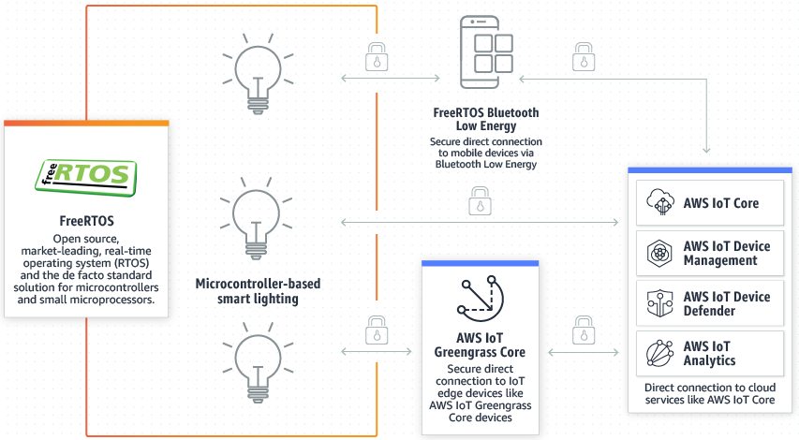
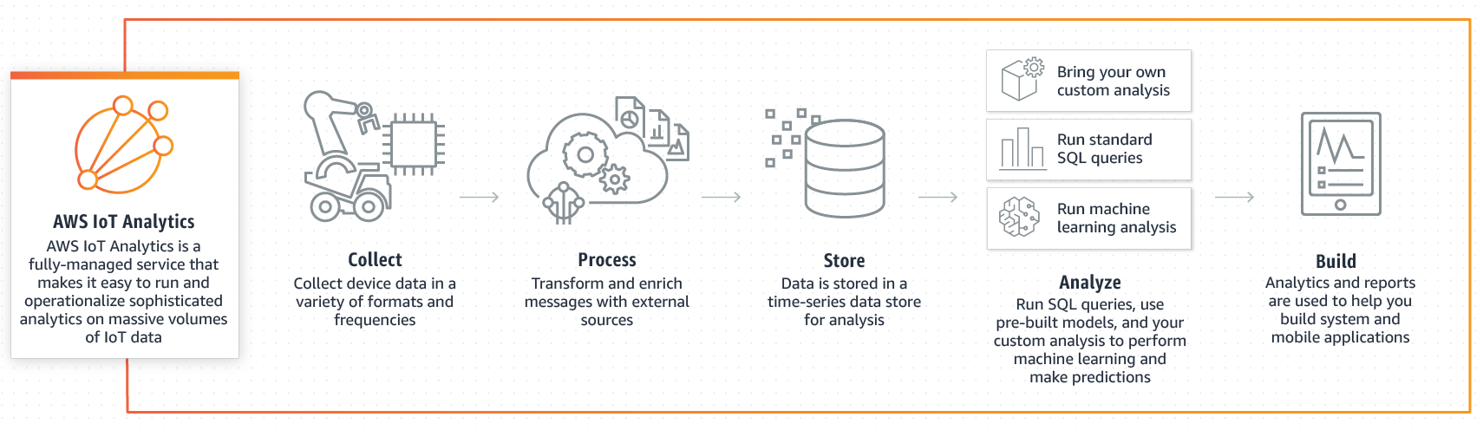
AWS IoT Services
Device Software
FreeRTOS
AWS IoT ExpressLink
AWS IoT Greengrass
Analytics Services
AWS IoT Analytics
AWS IoT SiteWise
AWS IoT TwinMaker
AWS IoT Events
Credit: https://aws.amazon.com/freertos/?nc=sn&loc=2&dn=1
Credit: https://aws.amazon.com/iot-analytics/?nc=sn&loc=2&dn=7
Notes:
Reference for contents:
https://aws.amazon.com/freertos/?nc=sn&loc=2&dn=1
https://aws.amazon.com/iot-expresslink/?nc=sn&loc=2&dn=2
https://aws.amazon.com/greengrass/?nc=sn&loc=2&dn=2
https://aws.amazon.com/iot-analytics/?nc=sn&loc=2&dn=7
https://aws.amazon.com/iot-events/?nc=sn&loc=2&dn=8
https://aws.amazon.com/iot-sitewise/?nc=sn&loc=2&dn=9
https://aws.amazon.com/iot-twinmaker/
More explanation:
FreeRTOS is an open-source real-time operating system for microcontrollers that makes it simple to programme, deploy, secure, connect, and manage small, low-power edge devices. FreeRTOS is an open-source operating system that contains a kernel and a growing set of software libraries that may be used in a variety of industries and applications. This includes securely connecting low-power devices to AWS Cloud services such as AWS IoT Core or more powerful edge devices running AWS IoT Greengrass. FreeRTOS is designed for dependability and ease of use, and it comes with the security of long-term support releases.
AWS IoT ExpressLink is used by AWS Partners such as Espressif, Infineon, and u-blox to power a variety of hardware modules. The connectivity modules include AWS-validated software that makes securely connecting devices to the cloud and integrating with a variety of AWS services faster and easier.
AWS IoT Greengrass is an open-source edge runtime and cloud service for building, deploying, and managing device software.
AWS IoT Analytics is a fully managed service that makes it simple to run and operationalize sophisticated analytics on huge amounts of IoT data without the cost and complexity of building an IoT analytics platform. It's the simplest approach to analyze IoT data and gain insights on how to make better, more accurate decisions for IoT applications and machine learning use cases.
AWS IoT Events is a fully managed service that makes detecting and responding to IoT sensor and application events simple. Events are data patterns that reveal more intricate circumstances than predicted, such as equipment modifications when a belt becomes stuck or motion detectors that use movement signals to trigger lights and security cameras. IoT Occurrences continuously monitors data from a variety of IoT sensors and apps, and it combines with other AWS services like AWS IoT Core and AWS IoT Analytics to provide early detection and unique insights into events. IoT Events responds to events by automatically triggering alerts and actions depending on the logic you establish, allowing you to swiftly fix issues, decrease maintenance costs, and improve operational efficiency.
AWS IoT SiteWise is a managed service that simplifies collecting, organizing, and analyzing industrial equipment data.
AWS IoT TwinMaker simplifies the creation of digital twins of real-world systems like buildings, factories, industrial equipment, and production lines for developers. AWS IoT TwinMaker gives the tools you need to create digital twins in order to improve building operations, production output, and equipment performance. Users can now employ digital twins to generate a comprehensive perspective of your operations faster and with less effort by combining existing data from numerous sources, creating virtual representations of any physical location, and combining current 3D models with real-world data.

Slide 34
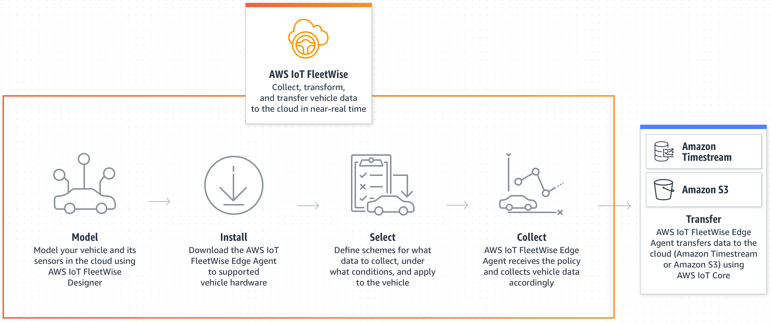
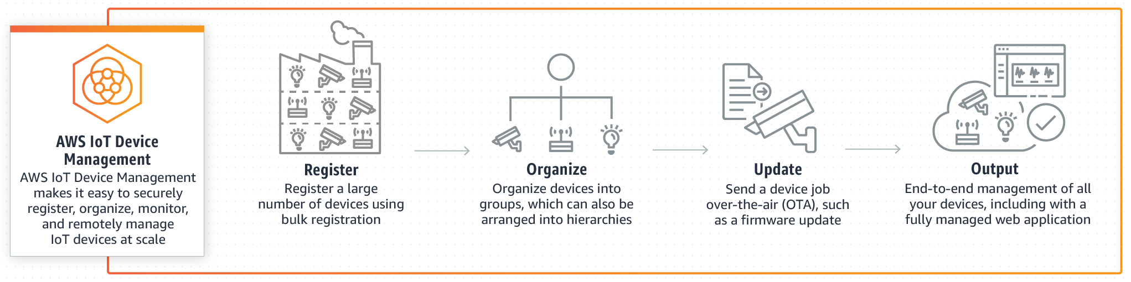
AWS IoT Services
Control Services
AWS IoT Core
AWS IoT Device Management
AWS IoT Device Defender
AWS IoT FleetWise
AWS IoT RoboRunner
AWS IoT 1-Click
Credit: https://aws.amazon.com/iot-fleetwise/
Credit: https://aws.amazon.com/iot-device-management/?nc=sn&loc=2&dn=4
Notes:
Reference for contents:
https://aws.amazon.com/iot-core/?nc=sn&loc=2&dn=3
https://aws.amazon.com/iot-device-management/?nc=sn&loc=2&dn=4
https://aws.amazon.com/iot-device-defender/?nc=sn&loc=2&dn=5
https://aws.amazon.com/iot-fleetwise/
https://aws.amazon.com/roborunner/
https://aws.amazon.com/iot-1-click/?nc=sn&loc=2&dn=6
More explanation:
It allows users to securely transmit messages to and from all IoT devices and applications with low latency and high throughput.
AWS IoT Device Management enables registering, organizing, monitoring, and remotely managing IoT devices at scale simple. Users can register your connected devices individually or in bulk using AWS IoT Device Management and manage permissions to keep them secure. Users can also use a fully managed web application to organize your devices, monitor and troubleshoot device functionality, query the status of any IoT device in their fleet, and send firmware updates over-the-air (OTA).
AWS IoT Device Defender is a fully managed solution for securing your IoT device fleet. AWS IoT Device Defender examines your IoT configurations on a regular basis to ensure that they aren't violating security best practises. A configuration is a set of technical controls you specify to help keep data secure when devices communicate with one another and with the cloud. Maintaining and enforcing IoT setups, such as assuring device identity, authenticating and authorizing devices, and encrypting device data, is simple with AWS IoT Device Defender. AWS IoT Device Defender checks your devices' IoT configurations against a set of established security best practices on a regular basis.
If there are any gaps in your IoT configuration that could pose a security issue, such as identity certificates being shared across several devices or a device trying to connect to AWS IoT Core with a revoked identity certificate, AWS IoT Device Defender will send you an alert.
AWS IoT FleetWise makes it simple and cost-effective for automakers to gather, convert, and transfer vehicle data to the cloud in near-real time, then use it to build applications that improve vehicle quality, safety, and autonomy using analytics and machine learning.
AWS IoT RoboRunner is a platform for connecting robots to work management systems and developing robotics fleet management applications.
AWS IoT 1-Click is a service that allows basic devices to call AWS Lambda programmes to do a task. Supported AWS IoT 1-Click devices make it simple to do things like notify technical support, track assets, and resupply goods or services. Supported AWS IoT 1-Click devices are ready to use right out of the box, eliminating the need for custom firmware or secure connectivity configuration. Devices that are supported by AWS IoT 1-Click can be simply handled. You may quickly construct device groups and correlate them with a Lambda function that, when activated, performs your desired action. The pre-built reports can also be used to monitor device health and activity.

Slide 35
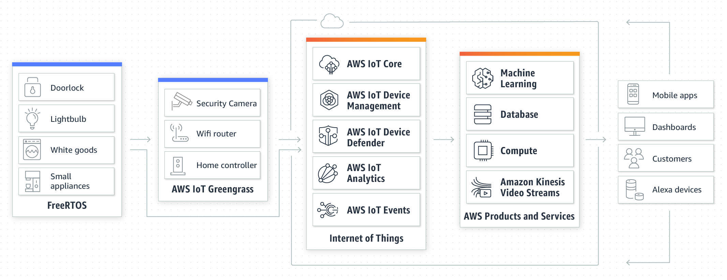
IoT for Connected Home Use Cases
How it works?
Credit: https://aws.amazon.com/iot/solutions/connected-home/
Notes:
Reference for contents: https://aws.amazon.com/iot/solutions/connected-home/

